Slide 1
An Intelligent Audio Recognition System for Online Product Advertisement
By
Sayed Khushal Shah
&
Zeenat Tariq

Slide 2
Project Idea
Motivation:
An intelligent audio recognition system for specially abled people
Significance:
Design of an intelligent audio recognition model will help the specially abled people who are not able to hear properly
The model will also have the features for advertisement of Online products

Slide 3
Objectives
Create a sound application for advertising companies using android platform
The API should have the features of augmented reality.
Real time audio recognition for the products of advertised Company
Recognize audio for the advertised products through Deep learning algorithms
Amplify the sound according to the hearing capability of the listener

Slide 4
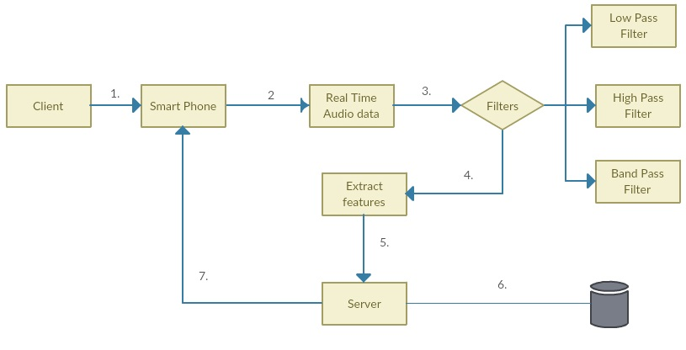
Proposed Workflow

Slide 5
Tools
Android Studio
Apache Spark
Tensor Flow

Slide 6
Thank you

